Slide 1
Books to Scrape: Web Scraping and Exploratory Data Analysis Using Python
Presented By :- Vishal Sanjay Raut

Slide 2
About me
Name :- Vishal Sanjay Raut.
Education :- Pune District Education Association College of Engineering Pune.
Why I Want To Learn Data Analyst :-
I enjoy understanding patterns behind data and explaining them clearly, which is why Data Analytics perfectly matches my problem-solving and presentation skills
Connect With Me :-
LinkedIn - www.linkedin.com/in/vishalraut
GitHub - https://github.com/vishalraut

Slide 3
Business Objectives
To collect structured book data such as price, rating, and availability from(Datset ss?) an online source using automated web scraping.
To analyze pricing and rating patterns to understand customer preferences and market trends.
To identify popular and highly rated books that can support better inventory and recommendation decisions.
To transform raw web data into actionable insights through exploratory data analysis (EDA).
To demonstrate an end-to-end data analytics workflow from data extraction to business-ready insights.

Slide 4
Web-Scrapping : Details
Data was collected from the Book To Scrap website.(
Books information was extracted using web scraping.
The dataset represents real-time, publicly available online book listings collected from the Books to Scrape website.
Scraped attributes include:
  Title
  Price
  Ratings
  Availability
  Category
  Stock
  Url

Slide 5





Data Summary
Database Schema
Data Source: Books to Scrape website (web scraped)
Data Format: Structured tabular data (CSV/DataFrame)
Total Records | 400 Books 8-9 (Columns)
Total Features
Categories Covered | 50+
Rating Levels | 5 (One to Five Star)
Price Range | £10-£60
Data Quality & Readiness
Minor missing values due to web scraping
Duplicate records identified and removed
Data cleaned, standardized, and prepared for EDA

Slide 6
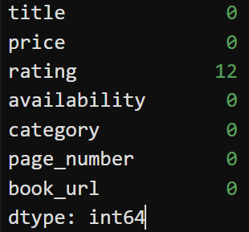
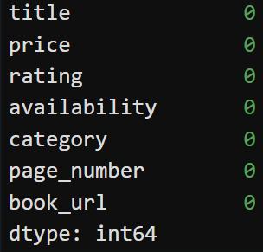


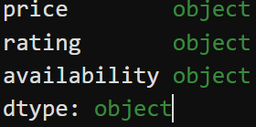
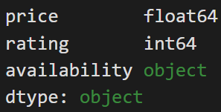
Data Cleaning
Missing Value Handling
Identified missing values in price, rating, and availability columns
Handled missing records using removal and logical imputation techniques
Missing values occurred due to incomplete HTML tags during web scraping
Data Type Standardisation
Converted price from text to numeric format
Transformed rating from text labels (e.g., “Three”) to numeric values
Removed currency symbols (£) and unnecessary characters
Missing Values
After handling missing values
After Converting data types
Before Converting data types

Slide 7
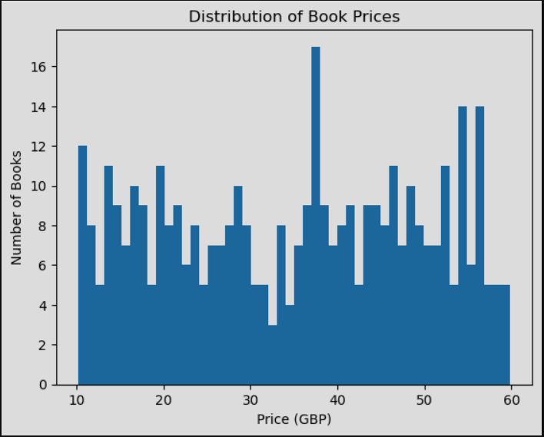
Distribution of Book Prices
Insights :-
The highest concentration of books lies in the £20–£40 price range
This shows that most books are moderately priced
Very few books fall in the extremely low or high price ranges
This graph shows the distribution of book prices.
Most books fall in the mid-price range, which indicates a focus on affordable pricing

Slide 8
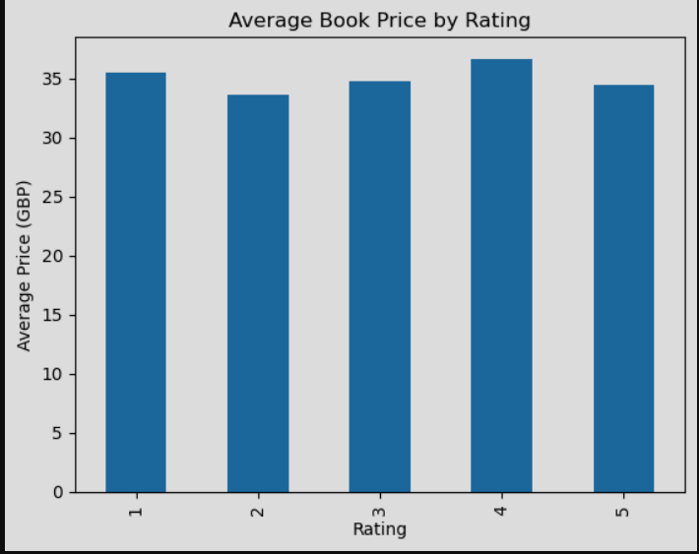
Average Book Price by Rating
Insights :-
Higher-rated books (4★) tend to have slightly higher average prices.
Price differences across ratings are small, showing pricing is fairly consistent.

Slide 9
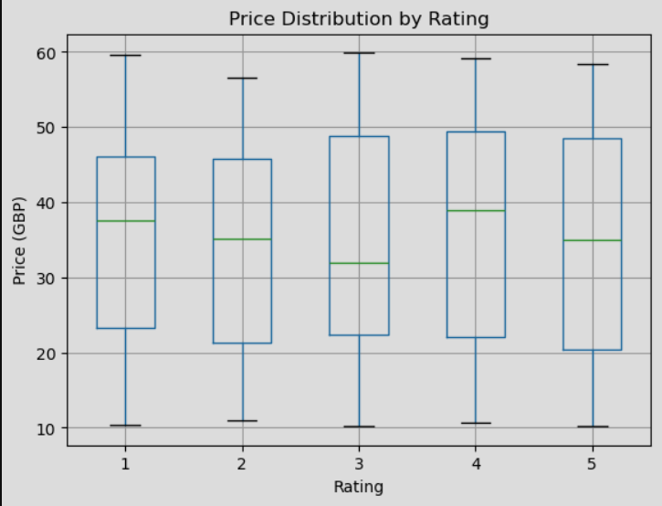
Price Distribution by Rating
Insights :-
Higher-rated books (4★) show a higher median price compared to lower ratings.
Price ranges overlap across all ratings, indicating rating is not the only factor influencing price.
This analysis compares prices across ratings.
Higher-rated books tend to have slightly higher prices, but overall, price differences are small.
This suggests that ratings alone do not strongly influence book prices

Slide 10
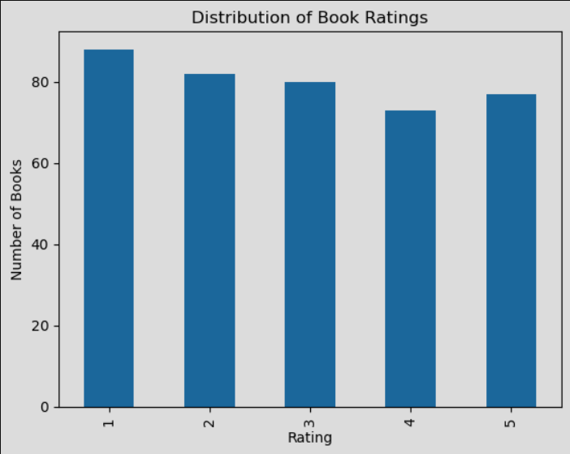
Distribution of Book Ratings
Insights :-
Lower ratings (1★–2★) appear more frequently than higher ratings.
Ratings are fairly evenly spread overall, indicating diverse reader opinions across books.
Here we can see how ratings are distributed.
Ratings are fairly spread, showing diverse reader opinions

Slide 11
Challenges
Dynamic and inconsistent HTML structure(attached ss for before data) across pages made element selection difficult
Missing or incomplete data due to unavailable tags during scraping
Text-based values (prices, ratings) required additional cleaning and conversion.
Pagination handling was needed to extract data from multiple pages
Ensuring data quality while removing duplicates and invalid records

Slide 12
Conclusions and Recommendations
Conclusions :-
Web scraping successfully extracted structured book data from the Books to Scrape website.
The dataset revealed balanced pricing with most books in the mid-price range.
Ratings and prices show a weak relationship, indicating price is not solely driven by ratings.
The cleaned dataset was analysis-ready and suitable for meaningful EDA.
Recommendations :-
Focus on mid-priced books, as they represent the majority of listings.
Use ratings along with other factors (category, popularity) for better recommendations.
Automate periodic scraping to track price and rating trends over time.
Extend analysis by including category-wise and sentiment analysis.

Slide 13
THANK YOU

